Slide 1
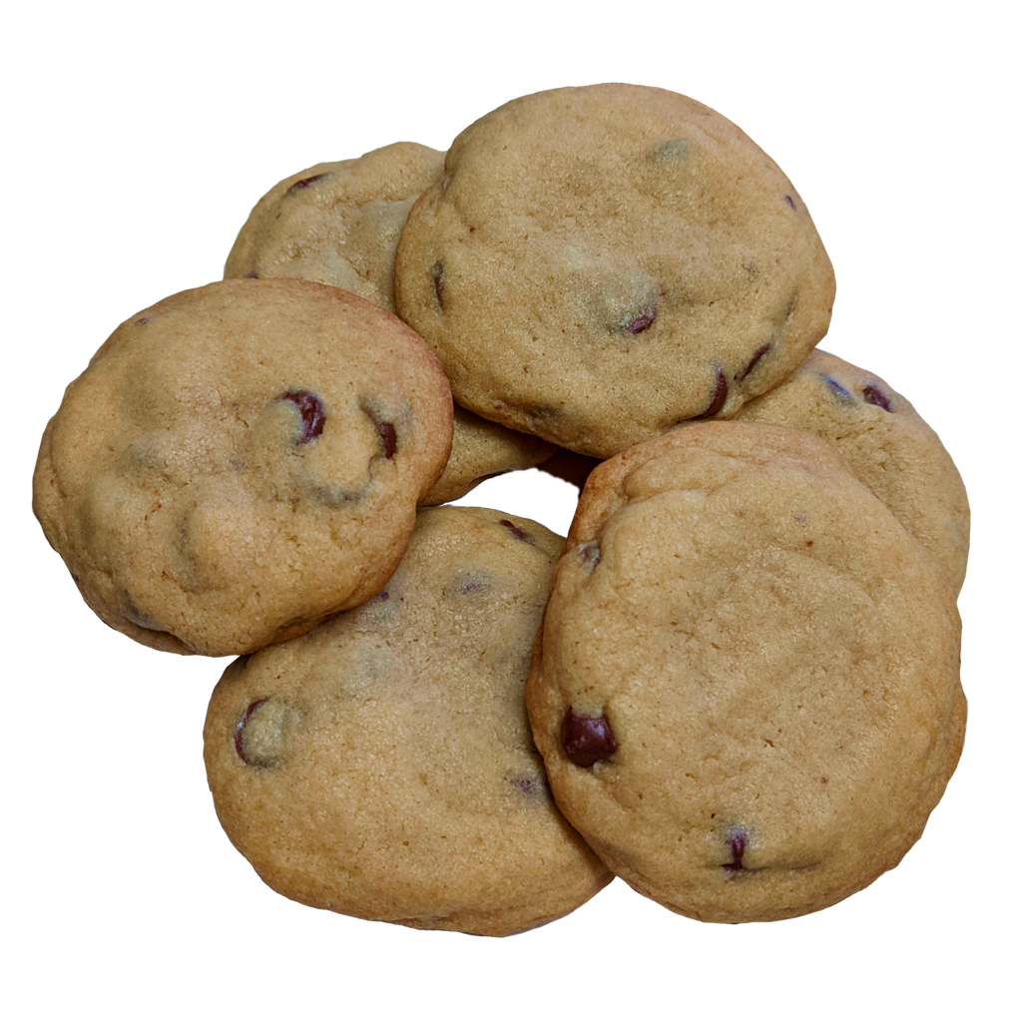
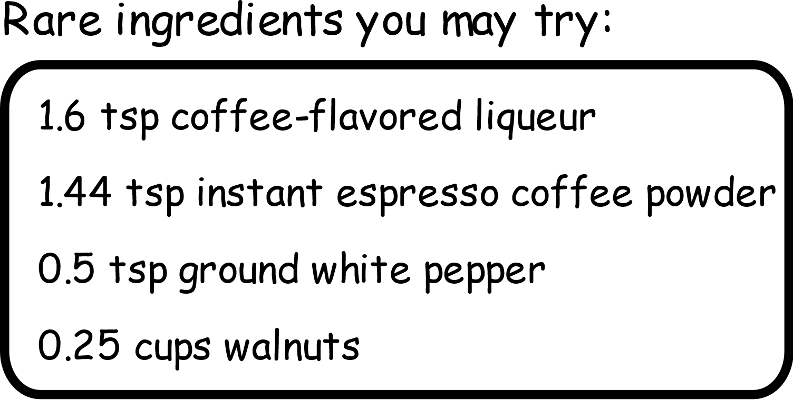
Median Chocolate Chip Cookies
Makes: 12 cookies
Median oven temp: 350.0 degrees F
Median bake time: 9.75 minutes
 | Grams | Volume
butter | 132.14 | 0.59 cups
white sugar | 99.97 | 0.46 cups
brown sugar | 105.77 | 0.52 cups
eggs | 63.81 | 0.26 cups
all-purpose flour | 217.8 | 1.53 cups
chocolate chips | 259.74 | 1.09 cups
vanilla extract | 3.64 | 0.84 tsp
baking soda | 2.87 | 0.54 tsp
salt | 3 | 0.28 tsp
Instructions:
Preheat oven to 350* F (177* C)
Cream together room temperature butter, white sugar, and brown sugar until smooth and fluffy
3. Mix in eggs and vanilla extract
4. Gradually stir in dry ingredients, being careful to mix as little as possible while still obtaining a homogenous mixture
5. Refrigerate dough for ~ 1 hour
6. Portion dough into 12 cookies and drop onto baking sheet
7. Bake at 350 degrees F for 9.75 minutes, until cookies are set but still gooey
* Let cool before removing from baking sheet

Slide 2
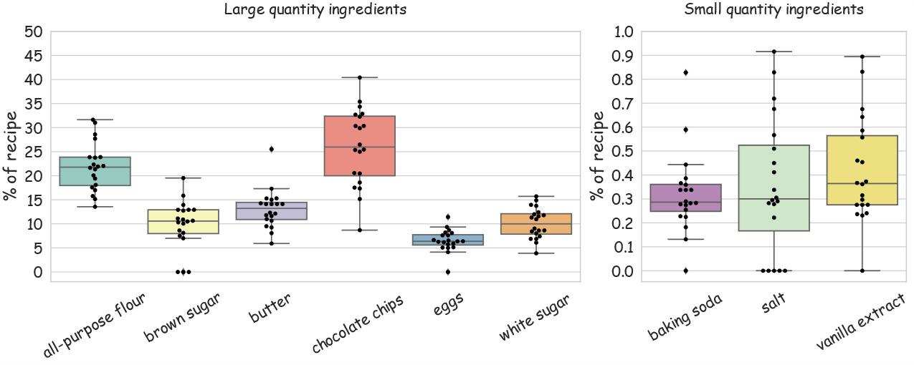
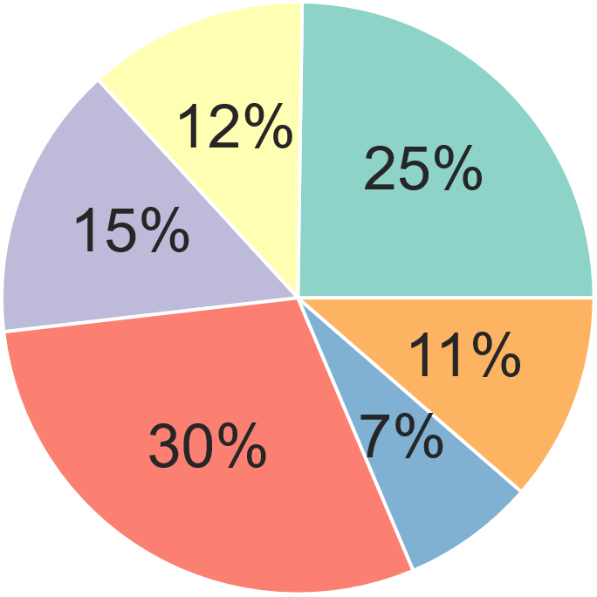
Variance across 20 recipes:
Large Quantity Ingredients
Small Quantity Ingredients
Average recipe by mass
Nutrients per cookie:
 | Energy | Protein | Total fat | Carbohydrate | Fiber | Starch
g | 219.70 | 2.74 | 9.76 | 31.07 | 0 | 0

Slide 3
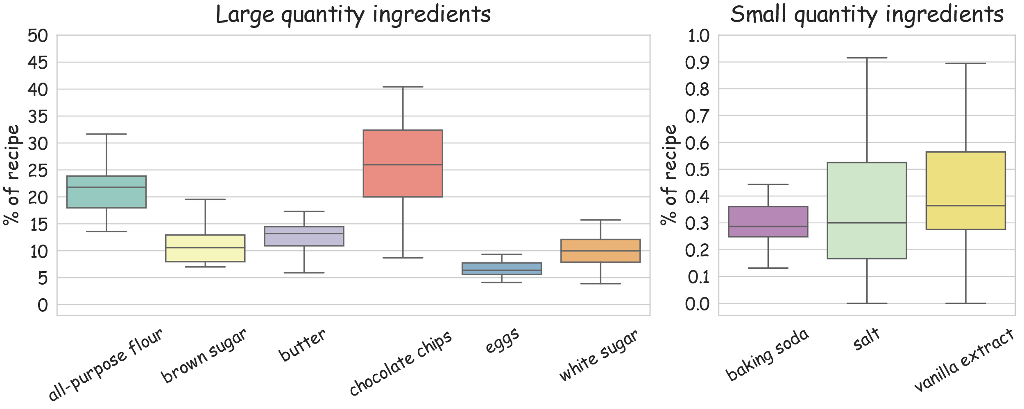
Median Chocolate Chip Cookies
Makes: 12 cookies
Median oven temp: 350.0 degrees F
Median bake time: 9.75 minutes
Instructions:
 | Grams | Volume
butter | 132.14 | 0.59 cups
white sugar | 99.97 | 0.46 cups
brown sugar | 105.77 | 0.52 cups
eggs | 63.81 | 0.26 cups
all-purpose flour | 217.8 | 1.53 cups
chocolate chips | 259.74 | 1.09 cups
vanilla extract | 3.64 | 0.84 tsp
baking soda | 2.87 | 0.54 tsp
salt | 3 | 0.28 tsp
1. Cream together room temperature butter, white sugar, and brown sugar
2. Mix in eggs and vanilla extract
3. Mix in dry ingredients
4. Refrigerate dough for ~ 1 hour
5. Portion dough into 12 cookies and drop onto baking sheet
6. Bake at 350 degrees F for 9.75 minutes
* Let cool before removing from baking sheet
Rare ingredients you may try:
Recipe by mass
1.6 tsp coffee-flavored liqueur
1.44 tsp instant espresso coffee powder
0.5 tsp ground white pepper
0.25 cups walnuts
Variance across 20 recipes

Slide 5
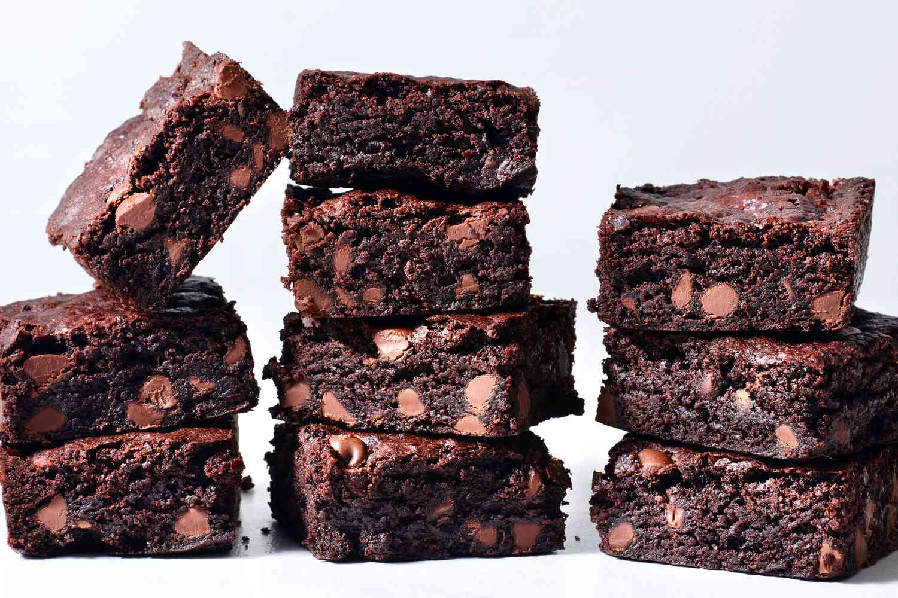
Median Brownies
Makes: 1 tray brownies
Median oven temp: 350.0 degrees F
Median bake time: 25-30 minutes
 | Grams | Volume
Butter | 100 | 0.45 cups
White sugar | 278 | 1.28 cups
Cocoa powder | 29.89 | 0.35 cups
Eggs | 155 | 3.5 eggs
All-purpose flour | 126 | 0.89 cups
Chocolate chips | 63 | 0.26 cups
Vanilla extract | 5.27 | 1.21 tsp
baking powder | 1.08 | 0.25 tsp
salt | 3.79 | 0.36 tsp
Rare ingredients you may try:
irish cream frosting
1 tsp brewed coffee
0.5 cup masala chai
4 ounces pureed prunes
0.5 tsp cinnamon
Instructions:
Preheat oven to 350* F (177* C)
Melt butter and chocolate chips in a small pan over low heat.
Whisk in cocoa powder, sugar, eggs, vanilla extract, and salt
Mix flour and baking powder together, then stir into batter just until combined (do not overmix)
Pour into baking tray
Bake in preheated oven for 25-30 minutes, or toothpick inserted in the center comes out with moist crumbs.
Cool completely before cutting

Slide 6
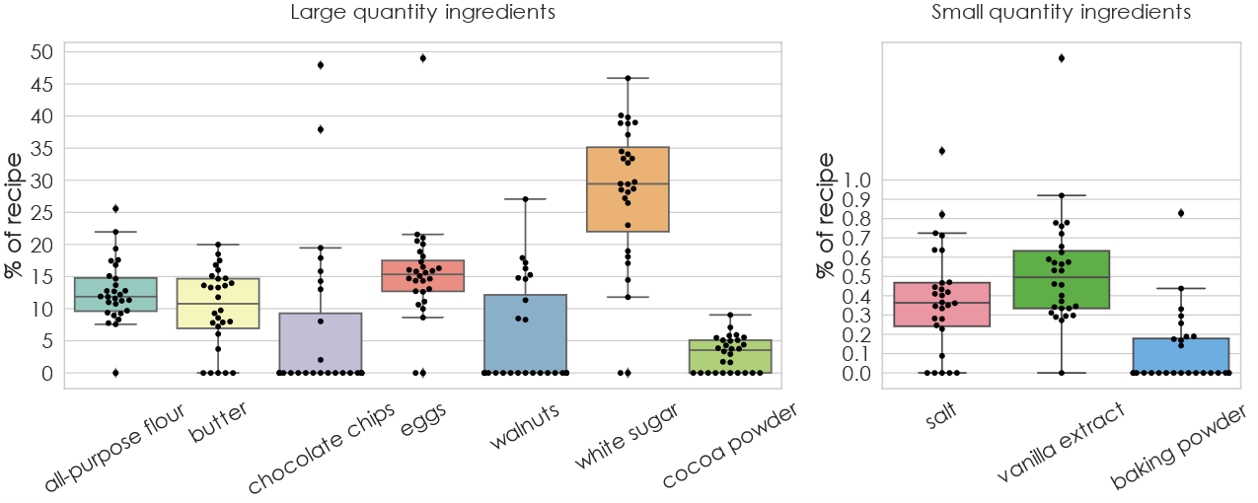
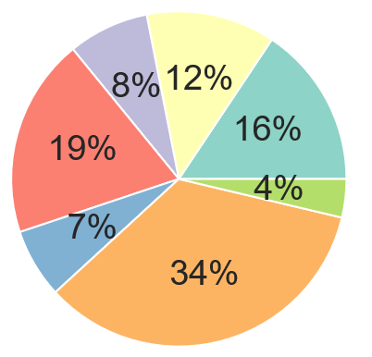
Variance across 28 recipes:
Large Quantity Ingredients
Small Quantity Ingredients
Average recipe by mass

